Slide 1


GAME DEVELOPMENT
DOBARIYA SAVAN Y.
2530401026-BCA

Slide 2


TOPICS
Introduction Of Game Development
Types Of Game
Game Design Process
Programming Languages
Core Game Engines
Graphics
Conclusion

Slide 3
INTRODUCTION OF GAME DEVELOPMENT
Game Development Means Creating Video Games.
It Includes Everything From : Designing Characters ,Writing Code, Creating Graphics, Adding Sound .
Development Is Supported By Project Management, Production, And Quality.

Slide 4

TYPES OF GAME
There Are Three Types Of Game :
Mobile Games
Pc Games
Console Games

Slide 5
GAME DESIGN PROCESS
Idea : Think Of A Game Concept
Design : Plan Gameplay, Rules And Characters
Prototype : Create A Simple Version
Testing : Check If Is’s Fun And Working

Slide 6
PROGRAMMING LANGUAGES
The Most Used Game Programming Languages Are C++, Python, Java, JavaScript.
C++ : It Is The Primary Language And High – Performance Game Engines Like Unreal Engine.
Python : Essential For Web- Based And Browser Games, Often Used With Framework .

Slide 7
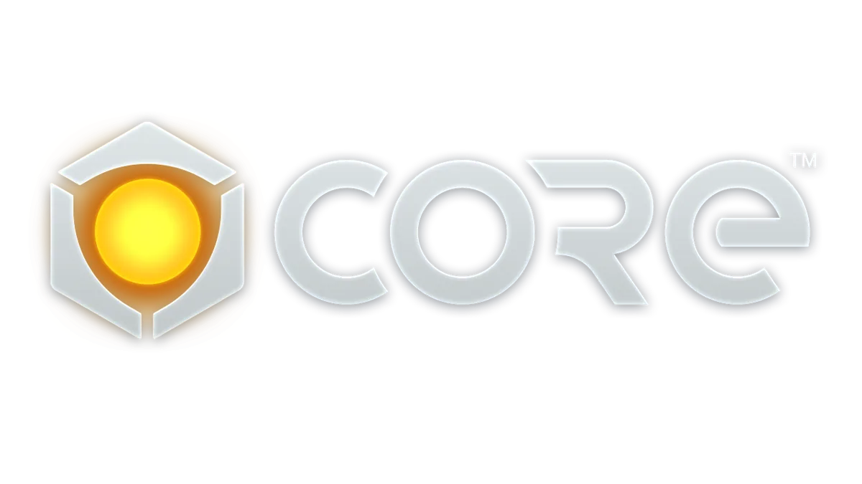
CORE GAME ENGINES
THERE ARE FOUR TYPES OF CORE GAME :
UNITY
UNREAl ENGINE
GOBOT
GAMEMAKER

Slide 8
CORE GAME ENGINES
Unity : The Most Popular Engine In 2025 Of Mobile Games. It Is Favored For Its Cross – Platform Support And Extensive Store.
Unreal Engine : Unreal Engine Is Powerful Game Development Software Used To : 3d Animations And Visual Effects.

Slide 9
GRAPHICS
Importance Of Game Graphics :
Makes Game Attractive
Improves Player Experience
Help Tell The Story
There Are Two Types Of Graphics :
2d Graphics
3d Graphics

Slide 10
CONCLUSION
Game Development Is A Technical Process Of Making Games That People Can Play And Enjoy.
It Combines Different Areas Like Game Design, Programming, Graphics And Sound To Build A Complete Game.
Game Development Requires Creativity, Logical Thinking And Problem- Solving Skills.

Slide 11
THANK YOU

